Slide 1
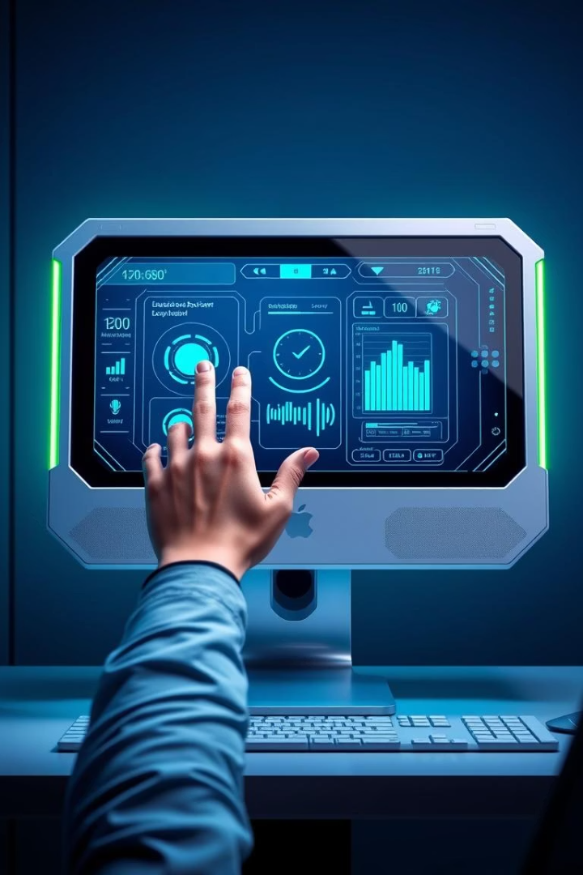
Gesture and Voice Control System
This presentation introduces an innovative computer interface system enabling hands-free control through natural hand gestures and voice commands. Designed for intuitiveness and efficiency, it empowers users to navigate and interact with their computers without relying on traditional input devices. Whether for accessibility, productivity, or industrial applications, this system combines cutting-edge technologies to transform human-computer interaction.
Team Members
Sanchi Mahajan(RA2311003011808) Shubhangi Sharma(RA2311003011809) Harshit Kulkarni(RA2311003011810)

Slide 2
Technology Stack Overview
Python Application
MediaPipe for Hand Tracking
SpeechRecognition Library
PyAutoGUI & CustomTkinter
Serves as the core programming environment integrating all components, enabling flexible development, and real-time processing.
Utilizes machine learning models to accurately detect and track hand landmarks in real time, providing gesture recognition foundations.
Enables robust voice command parsing using Google’s speech-to-text API or local alternatives for reliable hands-free input.
PyAutoGUI handles system control actions like mouse and keyboard events, while CustomTkinter delivers a user-friendly UI for seamless interaction.

Slide 3

Hand Gesture Control Modes
Navigation Mode (1 finger)
Scroll Up (2 fingers)
Scroll Down (3 fingers)
Scroll web pages or documents upward intuitively using two-finger gestures.
Scroll down content with a three-finger gesture, enabling quick navigation through long text.
Move mouse cursor smoothly based on single finger tracking for precise pointer control.
Click Mode (4 fingers)
Drag Mode (5 fingers)
Perform mouse clicks, including left, right, and double-click actions using a four-finger gesture.
Engage drag and drop functionality by clicking and moving objects with five fingers raised.

Slide 4
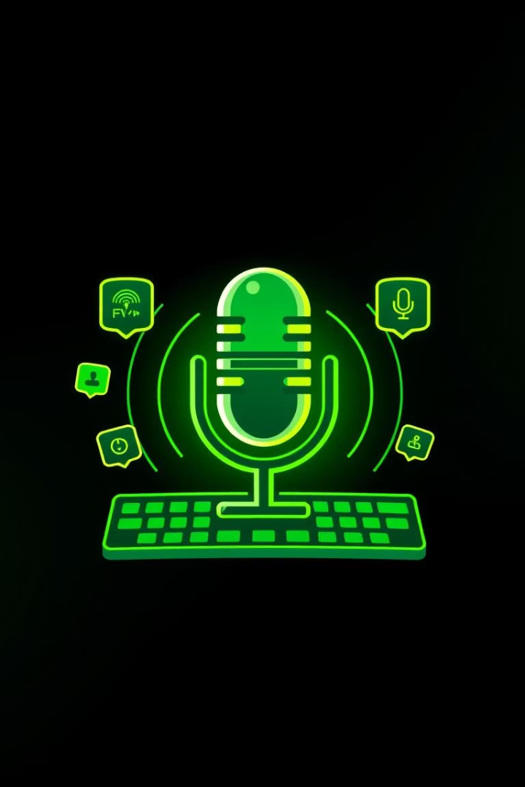
Voice Command Features
Mouse Commands
Click
Right-click
Double-click
Scrolling Controls
Users can verbally instruct scrolling actions without gesture input.
Text Input
Speak text to type dynamically, enabling hands-free writing (“type [text]”).
Keyboard Shortcuts
Execute keyboard commands by voice, e.g., “press Ctrl+C” for copying content.

Slide 5
Technical Implementation Details
Real-Time Hand Landmark Detection
Motion Smoothing Algorithms
Finger Counting Stabilization
Multithreaded Processing
Filter jitter and noise in detected movements to provide stable and responsive cursor control.
Consistency checks ensure gestures are recognized accurately by stabilizing finger count detection across frames.
Separates voice recognition and visual tracking to optimize responsiveness and system performance.
MediaPipe’s advanced models detect precise hand keypoints at high frame rates for smooth gesture capture.

Slide 6




Applications and Benefits
Accessibility
Hands-Free Computing
Extends computer use to users with mobility limitations through intuitive hands-free controls.
1
Allows users to operate devices without physical contact, improving convenience and hygiene.
2
Industrial Use
Presentations
4
Enables workers to control machinery or software where hands safety or cleanliness is critical.
Facilitates effortless slide navigation and interaction during meetings or public speaking.
3

Slide 7
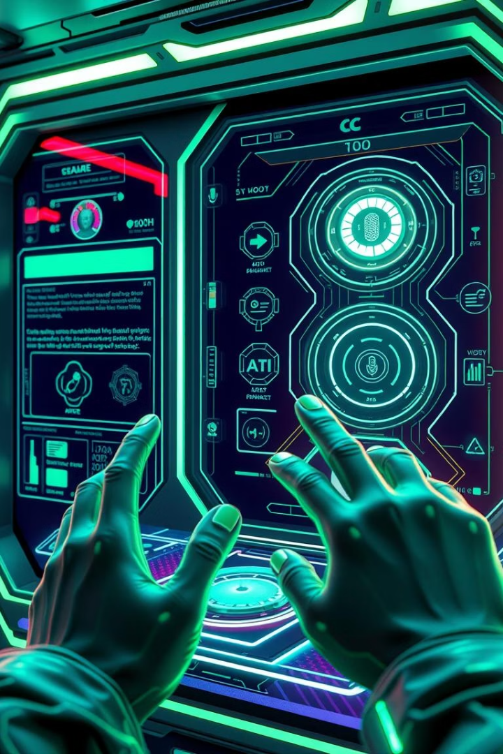




Future Enhancements
Enhanced Gesture Library
Incorporate more complex and customizable gestures to expand user commands.
AI-Powered Voice Recognition
Implement natural language understanding for conversational control beyond fixed commands.
Cross-Platform Compatibility
Extend system support to mobile devices, tablets, and various operating systems.
Adaptive Learning
Personalize control sensitivity and responsiveness based on user behavior over time.

Slide 8
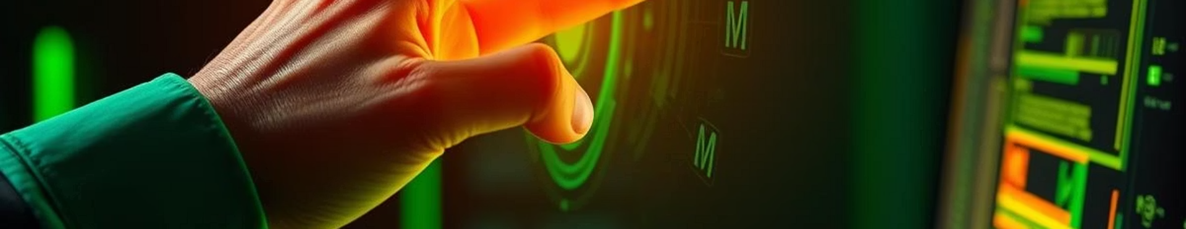
Conclusion and Key Benefits
Intuitive Interaction
Boosted Accessibility
Combines natural hand gestures and voice commands for effortless control.
Makes technology usable for a broader range of users, including those with disabilities.
Versatile Applications
Future-Ready
Suitable for work, presentations, industrial environments, and daily computing.
Built on a flexible tech stack ready for integration with AI and expanded control options.

